Slide 1

Why elements react to form compounds - ionic bonding
Lesson Objectives
To describe the structure of an ion and compare it with the structure of an atom.
To explain how ionic and covalent bonds are formed.
To write the formulae of some ionic and covalent compounds.
On your whiteboard, draw the structure of lithium and fluorine atoms.
Which group in the Periodic table are they in?

Slide 2
Ionic bonding
Meeting | Exceeding | Mastering
I can describe ionic bonding as the combining of a metal atom with a nonmetal atom. | I can explain why metals lose electrons to become positive ions and nonmetals gain electrons to become negative ions. | I can use the periodic table to draw accurate dot and cross diagrams to demonstrate ionic bonds.

Slide 3
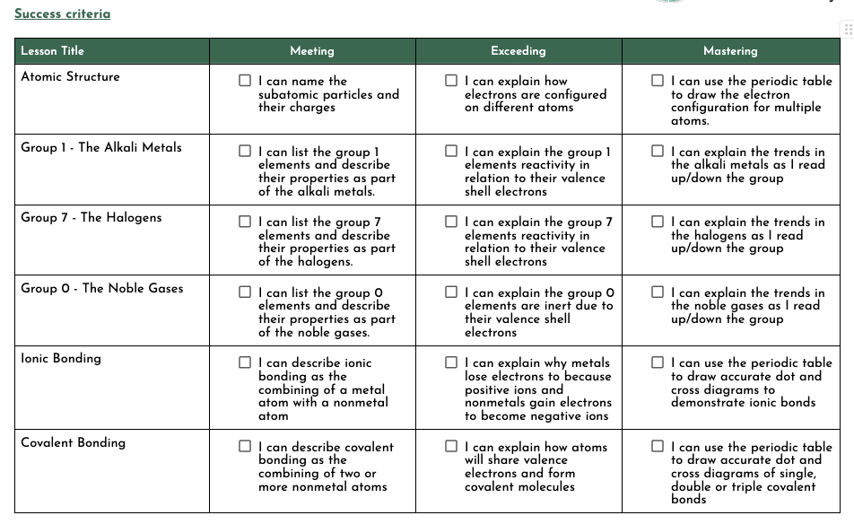

Slide 4
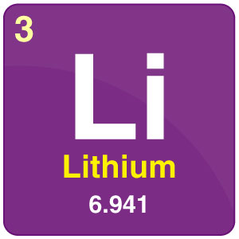
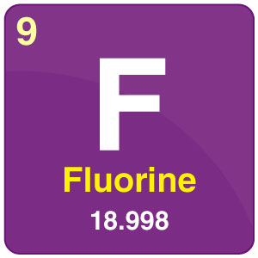
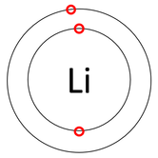
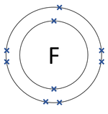
Group 1
[2,1]
Group 7
[2,7]

Slide 5
Outermost electron shell - the shell with the highest energy level is the one on the outside of an atom

Slide 6
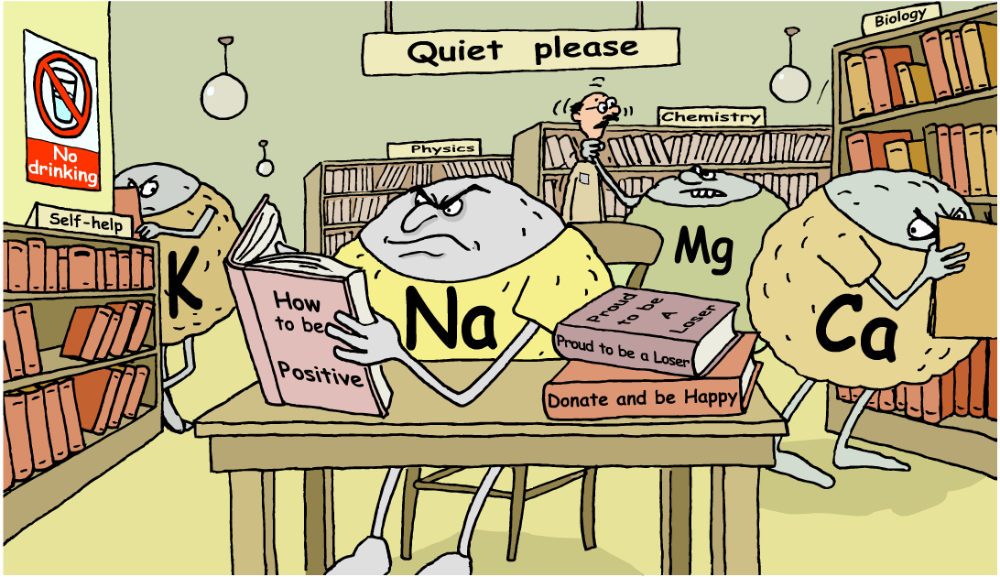
How can reactive atoms become stable?

Slide 7
Atoms are the more stable when the outermost electron shell is completely full of electrons.
Atoms can lose or gain electrons but they can also share electrons.

Slide 8
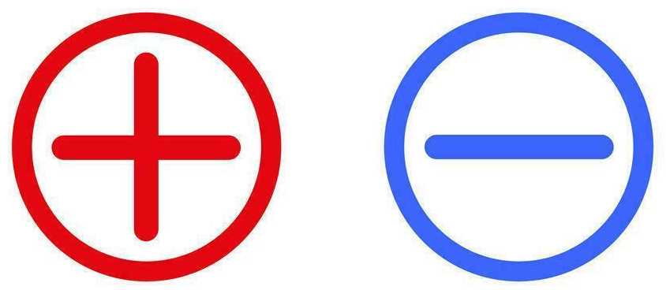
Ions
Ions are electrically charged atoms formed by loss or gain of electrons
An atom will lose/gain electrons to become more stable
  By making sure their outer electron shell is full

Slide 9


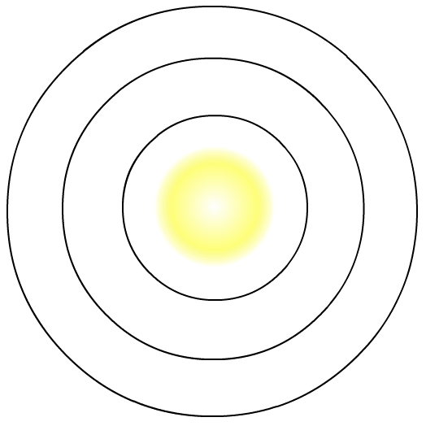
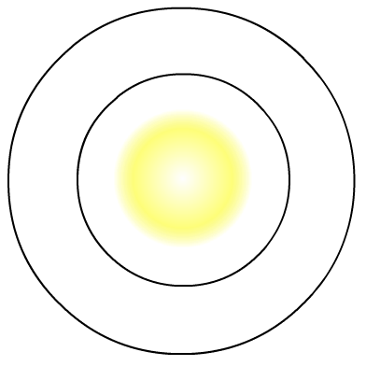
Sodium atom:
Sodium ion:
11 protons = +11
11 protons = +11
11 electrons = -11
10 electrons = -10
Total charge = 0
Total charge = +1
+
loses
1 electron
Na
Na
2.8.1
(partially full outer shell)
[2.8]⁺
(full outer shell)

Slide 10
Magnesium atom:
Magnesium ion:
12 protons = +12
12 protons = +12
12 electrons = -12
10 electrons = -10
Total charge = 0
Total charge = +2
2+
loses
2 electrons
Mg
Mg
2.8.2
(partially full outer shell)
[2.8]²⁺
(full outer shell)

Slide 11
Task: Complete for fluoride and chloride ions
_________ atom:
_________ ion:
? protons = + ?
? protons = + ?
? electrons = - ?
? electrons = - ?
Total charge = ?
Total charge = ?
?
loses/gains
? electrons
Mg
State electron structure
(partially full outer shell)
State electron structure
(full outer shell)

Slide 12
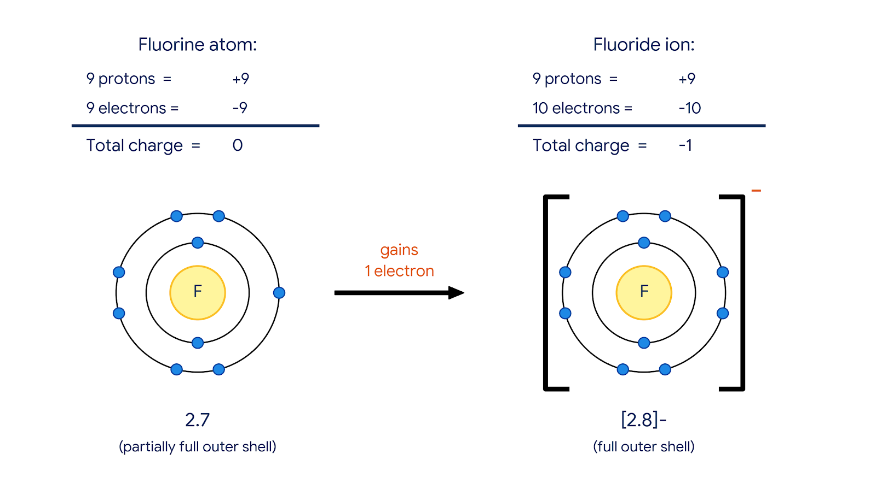

Slide 13
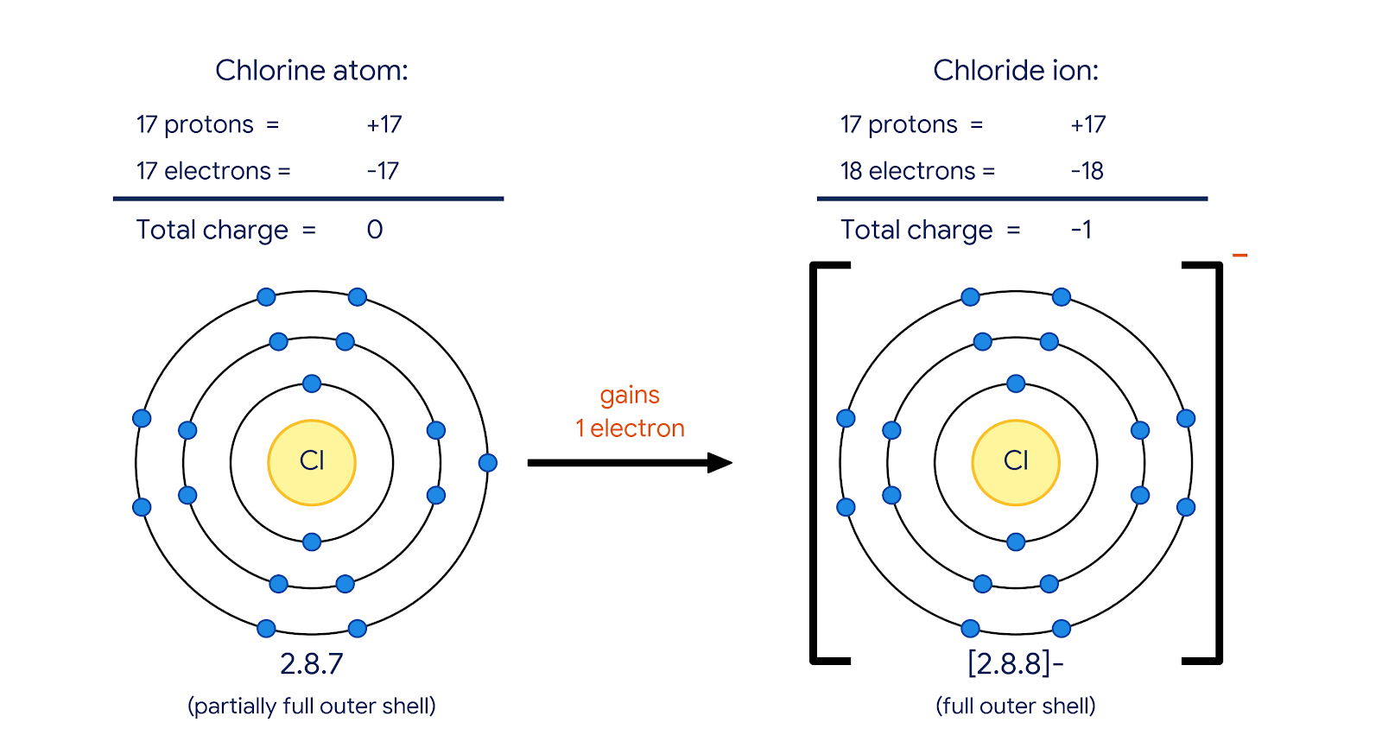

Slide 14
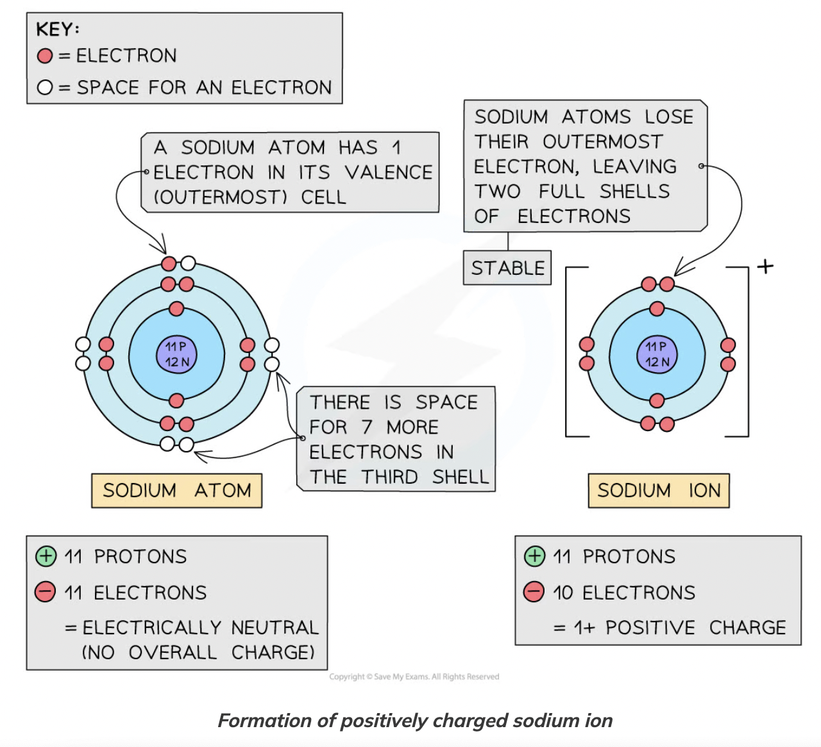
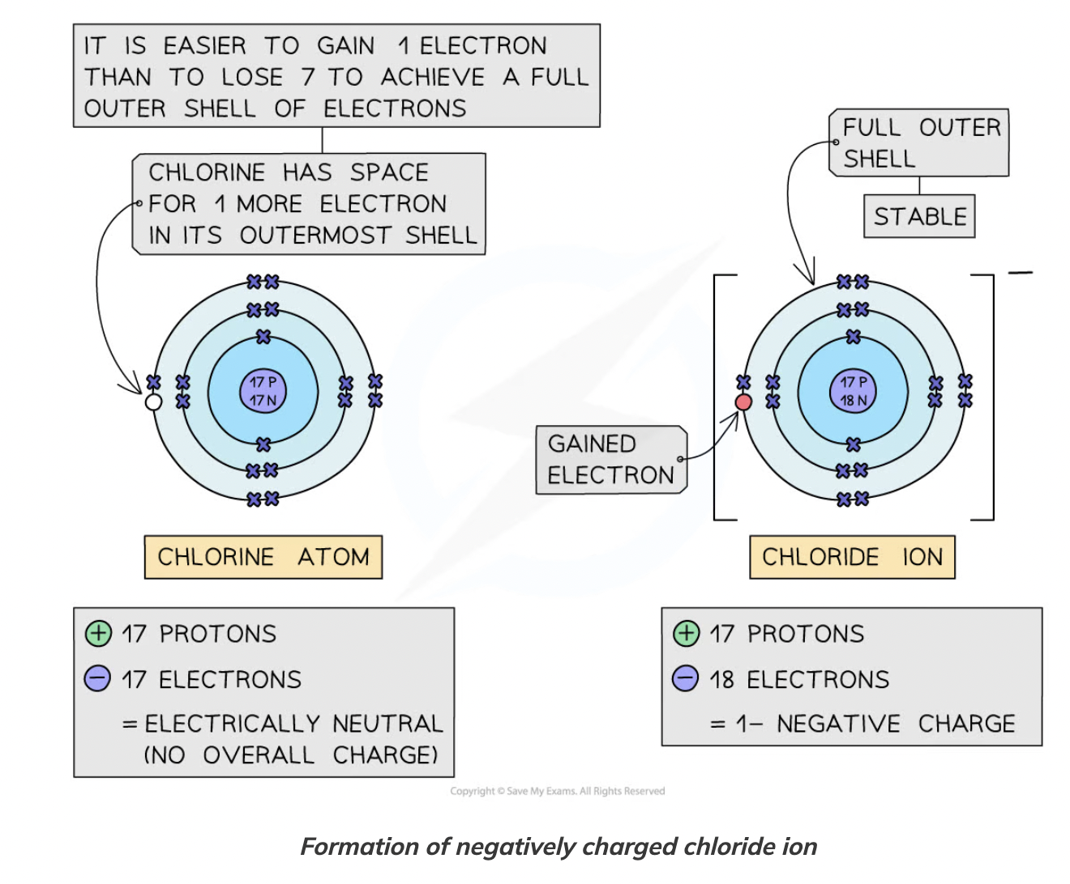

Slide 15
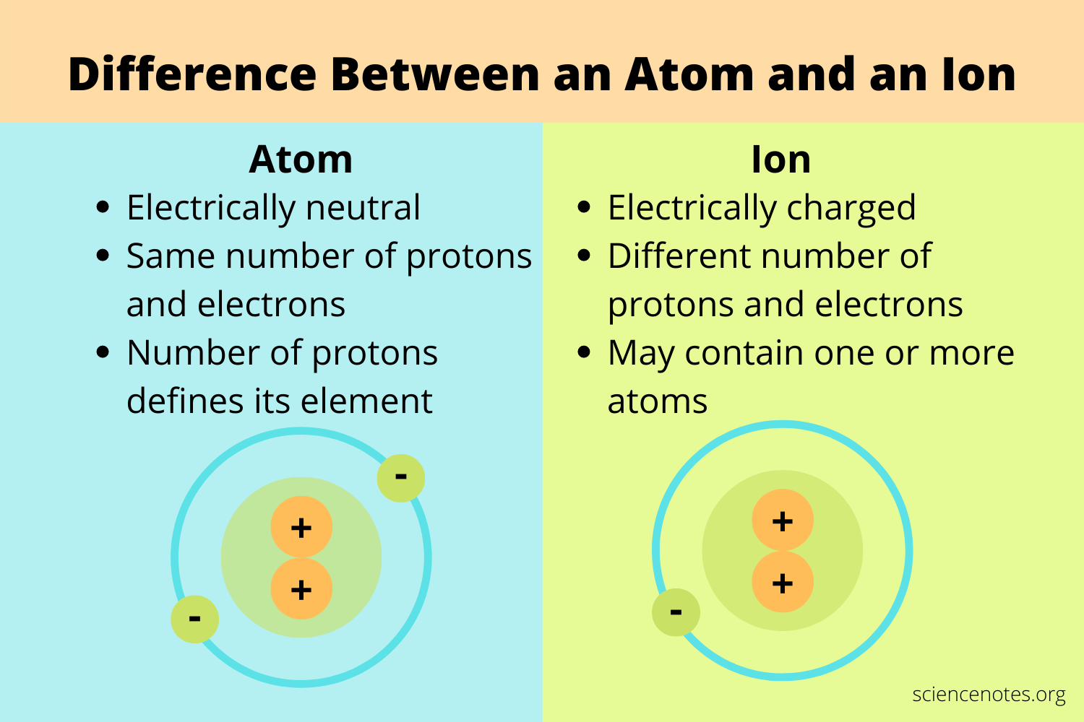
Notes:
“May contain one or more atoms” = An ion that contains more than one atom is called a polyatomic ion, which means a bonded group of atoms shares a net positive or negative electrical charge.
Eg: sulphate ion (SO₄²⁻), hydroxide ion (OH⁻)

Slide 16
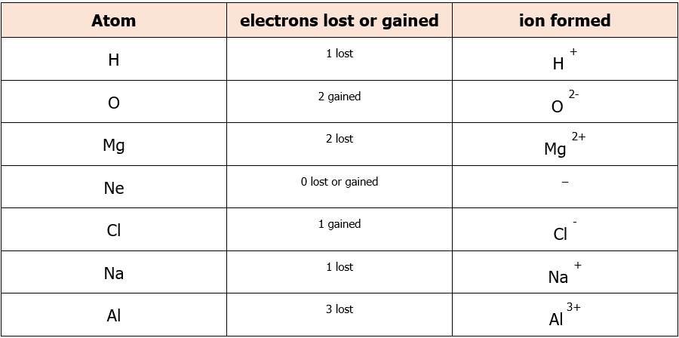
Copy and complete in your exercise books.

Slide 17
Ionic bonding
Ionic compounds are formed when metal atoms react with non-metal atoms
  Metal atoms = lose their outermost electron
  Non-metal atoms = gain electron(s)
Positive and negative ions are held together by strong electrostatic forces of attraction between opposite charges
This force of attraction is known as an ionic bond and they hold ionic compounds together

Slide 18
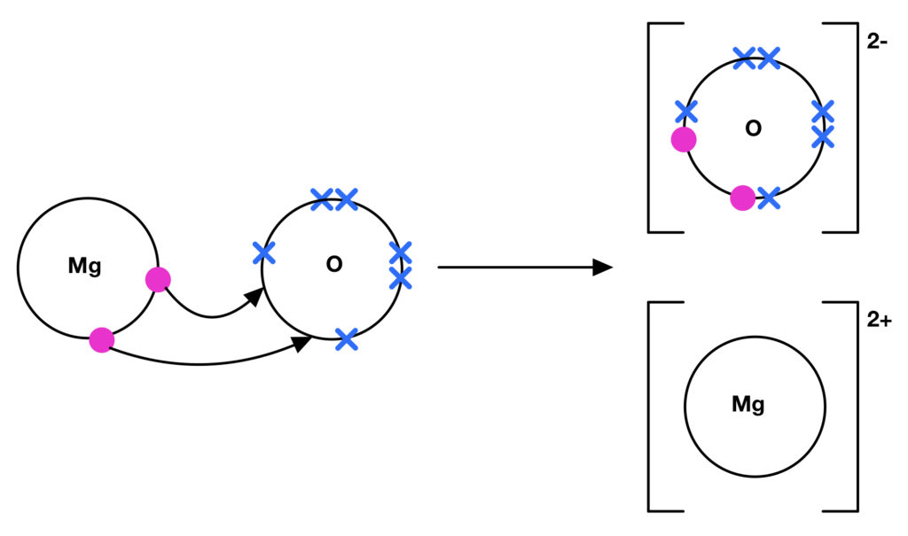
Ionic bonding
We can draw a dot-and-cross diagram to represent ionic bonding between magnesium and oxygen
Magnesium oxide
MgO
Usually only the outer shells of the atoms are shown. The electrons of one element are shown as dots and the other elements are shown as crosses (if there are more than two elements another symbol is used).

Slide 19
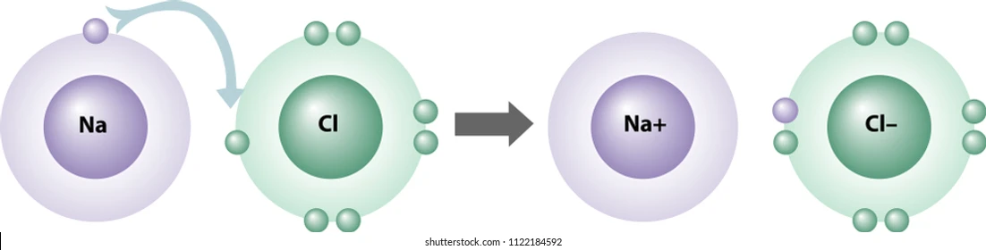
+
-
Sodium
Na
+
Chlorine
Cl
→
Sodium chloride
NaCl

Slide 20

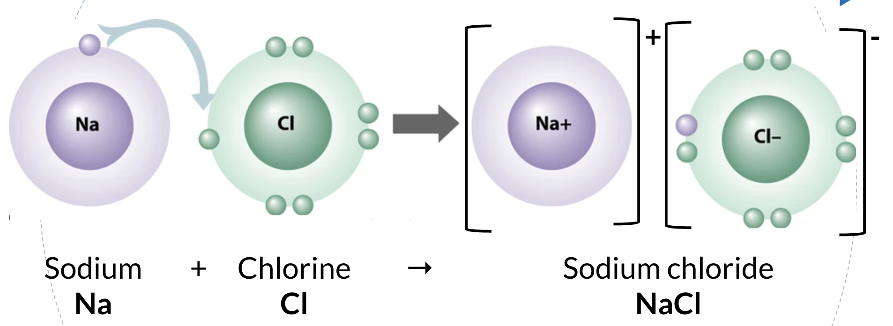
Forming ionic compounds
Choose one of the following metals and non-metals:
Metals:
calcium
magnesium
lithium
sodium
potassium
Non-metals:
fluorine
chlorine
oxygen
Challenge yourself by choosing a metal from Group 2 and a non-metal from Group 7 or a metal from Group 1 and oxygen
Illustrate the atomic structure of your chosen elements and show how an ionic bond is formed to make an ionic compound.
Show the reactants and new product as a chemical reaction.

